Slide 1

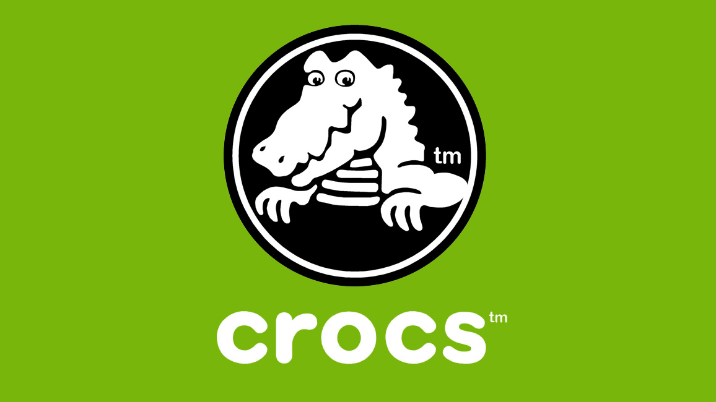
Team 4 - Decisions in Operations Management (6614-12) Final Project Perfect Fit Predicament: Navigating Crocs Sizing Challenges IN Online purchases
Team Members: -Akshitha Varada -Eesha Kumari Reddy -PranayKumar Garigaveni -Sai Goutham Jana -Srinu Swami Parvathaneni
Notes:
Hello Everyone
This is Team 4 -
Our topic is Address the sizing challenge faced by customers when purchasing crocs online.
Presenting our team members
Akshith varadha
Esha Kumari
Pranay Kumar
Sai Goutham
Srinu Swami

Slide 2

Customers' concerns about while purchasing crocs online: Challenges encountered by customers when purchasing crocs online, with the main issue being Fitting because crocs do not have universal Sizes, as well as other issues such as Material, Skin allergies, and insufficient Heel Support.
No Standardized Sizing
Model-Specific Sizing Variations
Challenges of Online Shoe Shopping
Notes:
Main Challenge for Crocs is Fitting issues is due to non universal sizing.
The primary concern for customers purchasing Crocs online is the inconsistency in sizing. Unlike many footwear brands that follow a universal sizing chart.
Crocs may vary in size due to their unique design material. This variance can lead to confusion and uncertainty when customers try to select the correct size remotely.
Due to this inconvenience has caused to customers, such as the need to return and exchange products.
Which not only affects their shopping experience but also leads to additional logistics and cost to company.
There were other issues with Material Quality, especially if they have not experienced Croc’s proprietary Croslite material before.
In this presentation let’s make data driven decision analyzing the customer review data which is focused on sizing to help improving product quality.

Slide 3
Data Source
Theoretical reference from research paper.
Hypothetical customer feedback survey.
Illustrated data of reviews from the e-commerce websites.
Comparative Financial Data from CIS Market Analysis website.
Notes:
Lets discuss data sources used in this project
multiple data sources have been utilized to gain a holistic understanding of the problem. This diversity ensures that the analysis is well-rounded and covers different facets of the issue.
We have taken a theoretical reference from the research paper based on quality control techniques in shoe manufacturing.
We have taken hypothetical customer feedback survey along with illustrated data of review from the e commerce websites.

Slide 4
Income Statement
FINANCIAL STRENGTH
Notes:
Thank you Esha,
Lets look at the financial statement of Crocs for trailing 12 months and analyst how is it performing with its direct competitors in the usa.
Such as Colombia, Skechers, Nike. These are apples to apples comparison.
As we can see that They are making just over $3,900 Millions Per Trailing 12 months. And their net income is pretty low which is 2.84%. There isn’t much profit out of their business.
Now Let’s take a look at financial strength of the company.
Crocs has debt2equity ratio of is 1.62 which indicates that company borrowed 1.62 times their equity.
And
Leverage ratio ie d2a ratio of 2.82 which indicates that company borrowed 2.82 times their asset.
And
It also also has very low quick ratio of 0.2 to cover their Immediate liabilities.
In other words they are burning cash to run their business.

Slide 5
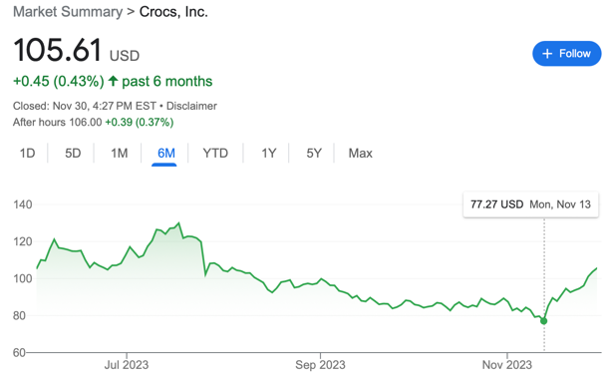
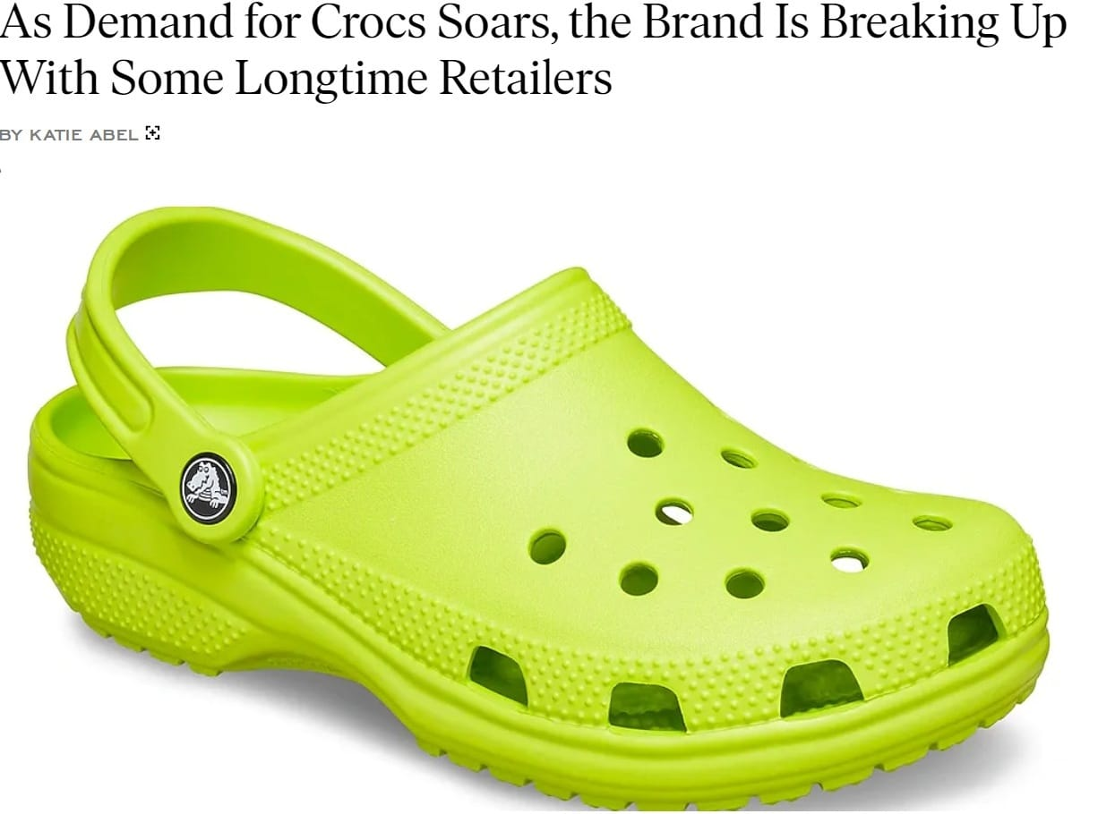
Notes:
When we look at their Stock Price. Croc has hit record low on nov 13 th .
They were in the brink of extinction as crocs lost some of its long term retailers.
There could be many reasons why crocs isn’t performing well in market, it could be lack customer retention rate due unsatisfactory reasons or any other.
Let’s look deeper into the insights and analyze the root cause of the issue.

Slide 6
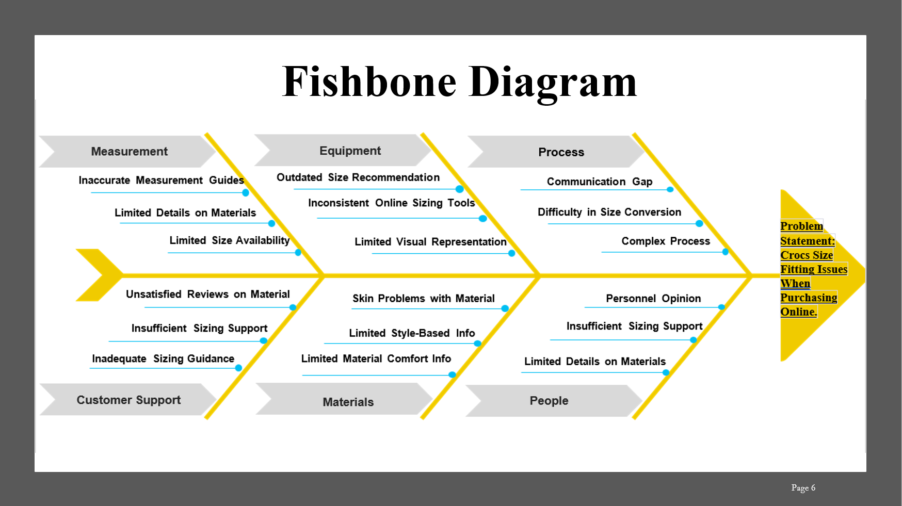

Slide 7

P-Chart dataset
Sub sample size of sales and the rejections of Crocs when purchased online from past 10 years are used for creating the P-Chart.
p-bar=total of Rejection/Total of Sub sample Size n-bar=Average of Sub Sample Size q-bar=1-(p-bar) Lower Control Limit=p-bar-3*sqrt(p-bar*q-bar/n-bar) Upper Control Limit=p-bar+3*sqrt(p-bar8q-bar/n-bar)
Notes:
The P-Chart is utilized to analyze and monitor Crocs online rejection rates, considering variations in sub-sample sizes over the past decade. Control limits are established to assess the statistical significance of rejection rate fluctuations.
Control Limits create the boundaries b/w Common cause variation and special cause variation Everything that falls Under UCL and LCL is typically Common cause variation. If data crosses the control limits, then it’s a special cause variation. Notably, the percentage of rejections has consistently exceeded the control limits at various points and mostly in 8, 9 and 10 indicating that they’re special cause variations. It is imperative for the company to proactively address and rectify the issue of rejections in order to maintain competitiveness in the market.

Slide 8
Notes:
The information pertains to the creation of a P-Chart for Crocs online sales rejections over the last 10 years.
The P-Chart serves as a statistical tool to monitor the proportion of defective items in the sales process.
We have considered the Sub-sample sizes of rejections for each time period are provided, ranging from 71 to 118.
We have the count of rejections for each sub-sample, Rejection percentages are calculated as rejections divided by the sub-sample size. Then we Calculated the P-bar, n-bar, and q-bar.
Lower Control Limit (LCL) and Upper Control Limit (UCL) for the P-Chart are calculated using standard formulas involving p-bar, q-bar, and n-bar.
Rejection percentages are compared against these control limits to identify statistically significant deviations from the expected rejection rate.

Slide 9
Pareto Chart
Notes:
Lets analyse the relative frequency of defects which as been reason for returning the orders.
Fitting issues was the most frequent reason
Where as there were other reasons such as friction blister, skin allergic reaction, excessive sweating, slipping sole, heel pain, unreliable sole.

Slide 10
Pareto Graph Analysis
Notes:
Now that we have this data, lets analyze using graph.
Since fitting issues was most common reasons for the return orders, cumulative % indicates that fitting issues alone would resolve 83% of overall problem.
And when we look at the second most reason friction blister. Both Fitting issues and friction blister would resolve 90% of the issues.
Through this Pareto chart we were able to analyze issue which had significant impact on return orders and through addressing that will have substantial impact reducing defects of the product.
We can consider this analysis to find the solution that can mitigate these issues in further.

Slide 11
Guess Estimation
Hypothetical Problem Statement - Due to the high rate of returns, Crocs faces financial difficulties because every returned item results in a loss of revenue. Evaluating the financial impact of these returns is essential to addressing and mitigating this problem.
Objective - The primary objective is to calculate the estimated loss incurred by Crocs due to the return of online orders.
Item Cost: The average cost of a product is $35.
Number of Orders: A total of 408 online orders have been processed.
Return Rate: 70% of the orders have been returned.
Estimated loss≈286×$35
Estimated loss≈$10,010
Intuition – Loss in this aspect does not directly indicate the revenue loss, it could be loss incurred by other factors such as Delivery Cost, Restocking cost, Out of Validation Item. Which indirectly affects revenue.
Notes:
Now lets do guess estimate on the loss insured to the crocs due to return orders.
These are hypothetical assumptions.
Let item cost be 35$
Number of orders be 408
And 70% of of the customers returned orders due to fitting issues.
Estimated indirect loss to crocs would be around $10K.
This isn’t direct loss to brand because, loss here could be other factors such as Delivery cost, restocking cost, out of time validation of design.
Moreover there are high chance that customer will not come back to purchase crocs again. As domino effect company can see drop in customer retention rate and drop in revenue as well.

Slide 12
Economic Design Specification – Taguchi law
9 Inches
9.14 Inches
22.86 Cms
23.22 Cms
Assumptions :
Economic Design Specifications
Target specification, T | 22.86 CMs (9 Inches)
k | $35.00
Loss due to Returns (Delivery, Restocking, Conditions due to return, Out of Validation item) | $6.00
Break-Even Tolerance | 0.41
Lower specification limit | 22.45
Upper specification limit | 23.27
Determining to Analyze the break - even tolerance in design implementation to mitigate the risk to returning due to fitting issue.
Notes:
Now Using Economic Design specification in Taguchi law.
Lets determine the break even design specification for crocs that the design team can take in consideration in manufacturing the products .
Let’s assume that target specification are currently 22.86 cms ie 9inches size of clog.
Let the Cost be $35
And
Loss estimated is $6
Now the Taguchi law suggests us that the if the design of the product was built around 23.27 cms which is 9.14 inches that would have mitigated risk of returning due to fitting issue.
From this insight , Design team can also take mid sizes in consideration while manufacturing the products.

Slide 13

Recommendations for the Company
Utilize Customer Feedback
Providing Detailed Online Sizing Information
Introducing mid sizes like (9.5”,8.5”…)
Conduct Market Research
Enhance Quality Control Processes
Notes:
Utilize Customer Feedback:
Actively gather and analyze customer feedback on sizing. Leverage this information to make data-driven adjustments to sizing standards and address specific customer concerns.
Provide Detailed Online Sizing Information:
Enhance the online shopping experience by providing detailed sizing information for each Crocs style. Include fit guides, material details, and customer reviews to help customers make informed decisions.
Transparent Communication:
Clearly communicate any variations in sizing for specific styles and provide guidance on how customers can choose the right size based on their preferences and foot shape.
4.Conduct Market Research:
Stay informed about market trends and customer preferences related to sizing. Adjust sizing standards based on evolving fashion trends while ensuring consistency and comfort.
5.Enhance Quality Control Processes:
Strengthen quality control measures during the sizing phase to detect and rectify variations early in the production process. Regularly audit and update these processes to maintain accuracy.

Slide 14
Key Learnings
Problem encountered by customers while purchasing through online.
Fostering data-driven approach to analyze return orders.
Utilizing tools like P Chart, Pareto Graph, Ishikawa diagram to resolution to unsatisfactory return orders.
Making crucial development changes to win-back customers.
Notes:
Company was able to encounter problems faced by customer while purchasing crocs online.
Through the data driven approach we got the insights on the customer feedback upon the return order.
They were able to utilize tools like P-Chart, Pareto Chart, Fishbone diagram, to find the resolutions and to take crucial decisions.

Slide 15
References
Addis, S. (2019) Statistical Quality Control - idpublications.org. https://www.idpublications.org/wp-content/uploads/2019/11/Full-Paper-STUDY-ON-THE-APPLICATION-OF-STATISTICAL-QUALITY-CONTROL-TECHNIQUES-IN-SHOE-MANUFACTURING.pdf
Amazon AWS. (2022). Crocs 2021 Comfort Report. http://q4live.s22.clientfiles.s3-website-us-east-1.amazonaws.com/133460125/files/doc_downloads/2021_Crocs_ESG_Report.pdf
CSIMarket. (n.d.). Crox’s comparison of quarterly growth rates to its customers (no date) https://csimarket.com/stocks/competitionNO3.php?markets&code=CROX

Slide 16
Thank You.

